Slide 1
HEART DISEASE ANALYSIS
Giridhar Kumar Maurya

Slide 2
PROJECT DESCRIPTION
The Heart Disease Analysis project aims to provide a comprehensive understanding of the factors contributing to heart disease and to develop predictive tools for assessing individual risk. By leveraging data-driven insights, the project will aid healthcare providers in making informed decisions, improving patient care, and implementing effective preventive measures to reduce the incidence and impact of heart disease.

Slide 3
PROJECT APPROACH
Gather data from reliable sources such as medical records, public health databases, clinical studies, and patient surveys.
Collect data on patient demographics (age, gender, etc.), lifestyle factors (smoking, physical activity, diet), medical history (hypertension, diabetes, family history), and clinical measurements (cholesterol levels, blood pressure, ECG results).
Create new features that might be relevant for analysis, such as BMI (Body Mass Index), age groups, and derived clinical measures.
Calculate basic statistics for key variables (mean, median, standard deviation, Correlations).
Identify the most influential features contributing to heart disease prediction.

Slide 4
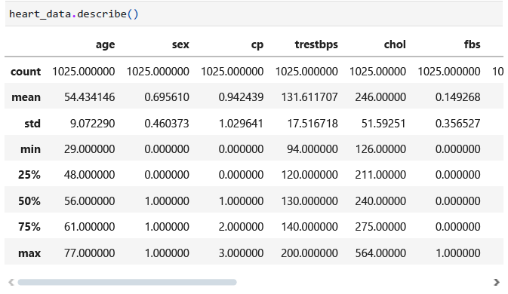
HEART DATA STATICS

Slide 5
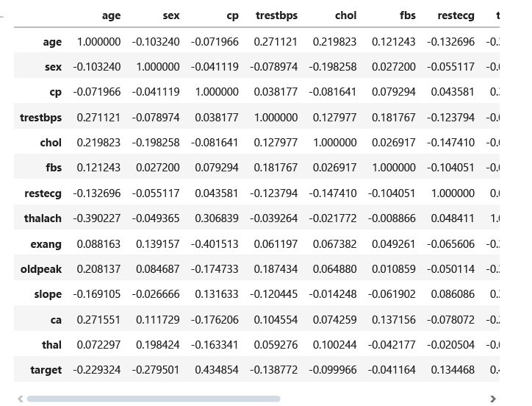
HEART DATA STATICS

Slide 6
HEART RATE STATUS

Slide 7
HEART DISEASE BY AGE AND SEX

Slide 8
HEART RATE BY AGE

Slide 9
HEART RATE DISTRIBUTION

Slide 10
HEART RATE DISTRIBUTION

Slide 11
Conclusions
The Heart Disease Project successfully provided actionable insights into the detection, prediction, and management of heart disease. By leveraging data-driven approaches, healthcare providers and policymakers can implement effective strategies to reduce the prevalence and impact of heart disease in populations. Future research and implementation efforts should focus on refining predictive models, integrating new data sources, and continuously evaluating the effectiveness of preventive and treatment strategies to improve cardiovascular health outcomes.

Slide 12
THANK YOU

